Slide 1
Assignment
Sun Tao
S1038988
14/5/2025
Cloth Recommend App

Slide 2
Total
Background: This is a desktop application developed using Python Tkinter that provides clothing recommendations based on weather conditions. The application takes user inputs including age, gender, and country to generate personalized clothing suggestions..
Intro: The application features core functionalities including user information collection, weather data retrieval, clothing recommendations, and graphical interface display. It uses Python as the development language, Tkinter for GUI construction, type annotation system for code readability and maintainability, and modular design to encapsulate business logic in the utils module..
Design pattern(Singleton): The project employs Object-Oriented Design patterns, with the ClothingRecommendationApp class as the core class encapsulating all functionalities. It follows the Single Responsibility Principle, clearly separating UI component creation, event handling, and business logic, while processing core business logic through the utils.Info module, achieving high cohesion and low coupling in the code.
SDLC(Waterfall): The project follows the Waterfall development methodology, with clear planning in each phase from requirements analysis, system design, implementation to testing. This includes clearly defined user input requirements, well-designed class structure, modular code organization, and comprehensive error handling mechanisms, ensuring project maintainability and reliability

Slide 3
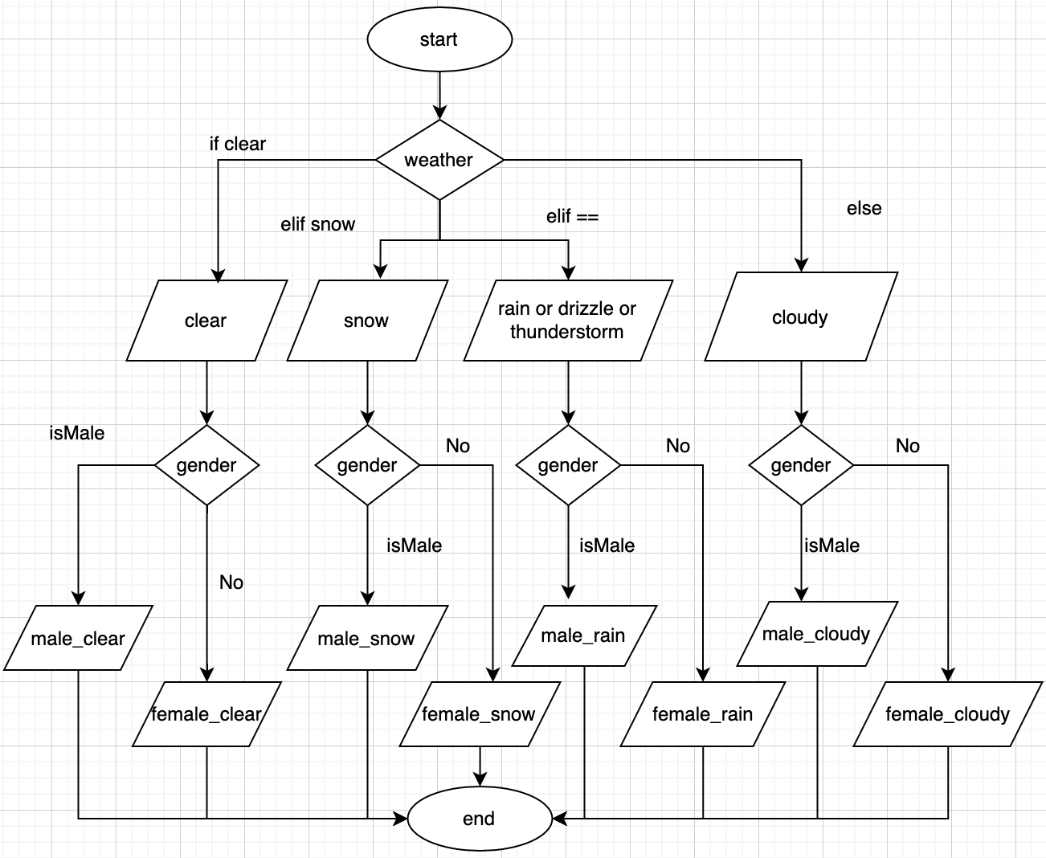
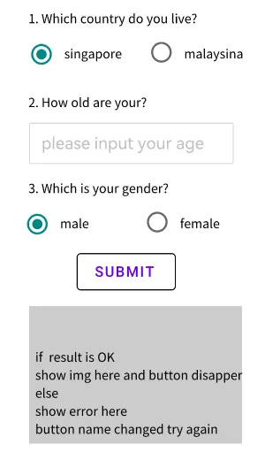
FlowChart on 2 of parameters
Wireframe

Slide 4
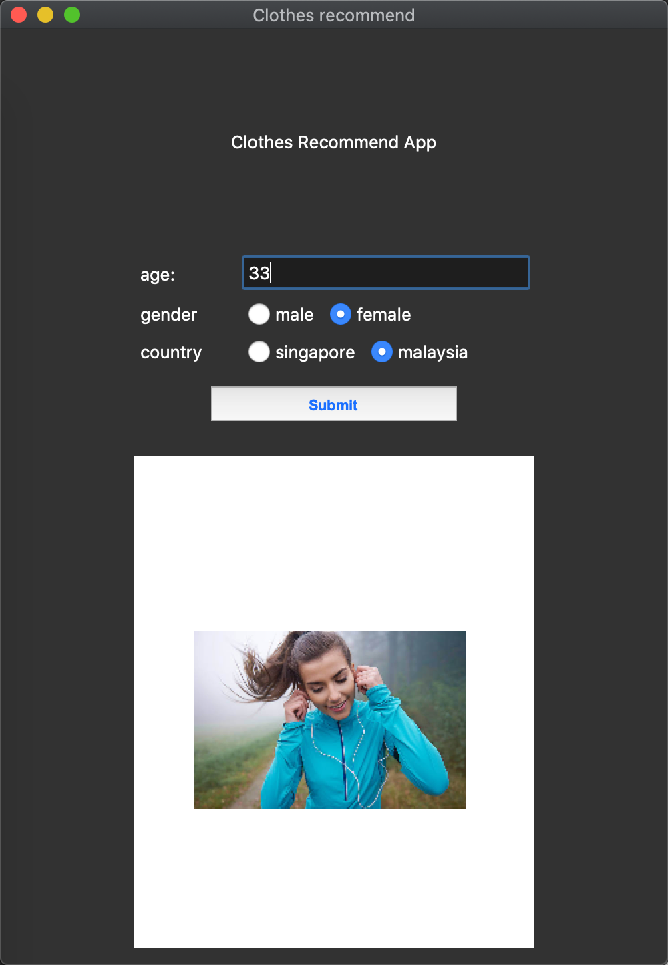
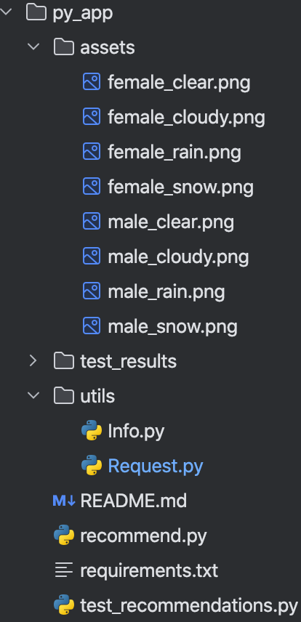
App page and API
API used
1.name: Weather Api
Provider: RapidAPI
document:https://rapidapi.com/worldapi/api/open-weather13
2.Description
Return weather-related information of the local area according to the input country.
Constructor
assets: image resources
utils : tools
------Info function and variables
------Request: request singleton class
recommend: main entry
requirements: dependencies
test all conditions with gender and weather

